Slide 1
Google forms and the art of the survey
http://lamthuyvo.github.io/cuny2015-socialjournalism/

Slide 2
Survey design
What to ask, how to ask, how it can be helpful

Slide 3
Survey design
Identify a topic
Notes:
Source: http://www.pewresearch.org/methodology/u-s-survey-research/questionnaire-design/

Slide 4
Survey design
vs.
cross-sectional
panel
or
longitudinal
Identify type of survey
Notes:
cross-sectional = different people of the same population at multiple points in time
longitudinal = survey with the same people over time (harder, more expensive, but yields better info on changes of a specific population over time, rather than just a poll)

Slide 5
Survey design
What are the most important issues in your community?
jobs
education
services
other
What are the most important issues in your community?
vs.
Open or closed-ended questions

Slide 6
Survey design
sometimes used to narrow down options for closed-ended questions
Open-ended questions
Notes:
open =
close =

Slide 7
Survey design
can be better for data analysis and visualization over time
closed-ended questions

Slide 8
Survey design
for complicated issues, choose 1-5 options
closed-ended questions — best practices

Slide 9
Survey design
The order of your options matters!
try to randomize it if you can
closed-ended questions — best practices

Slide 10
Survey design
when asking for a fact, like religious affiliations, you can list a lot more
closed-ended questions — best practices

Slide 11
Survey design
when asking for a classification of a concept on a scale (e.g. excellent, good, fair, poor), don’t randomize the but put them along the continuum
closed-ended questions — best practices
Notes:
(though feel free to reverse the order, so go from poor to excellent and then excellent to poor in different questions)

Slide 12
Survey design
?
The wording of your questions matters.
Question wording
Notes:
(in order of size of population adhering to fact)

Slide 13
Survey design
?
Choice of words can spook or influence your audience in ways that would change the outcome of your survey
Question wording
Notes:
(in order of size of population adhering to fact)

Slide 14
Survey design
?
for open-ended questions:
make sure the respondents know they can answer in their own words
tell them what kind of answer you want (a paragraph text, a month, number of days, etc.)
Open-ended questions
Notes:
open =
close =

Slide 15
Survey design
?
for closed-ended questions:
list of options should be exhaustive
response options should not overlap/be mutually exclusive
closed-ended questions — best practices

Slide 16
Survey design
?
Only ask one question at a time
(no double-barreled questions!)
Question wording

Slide 17
Survey design
?
Use simple and concrete language
Don’t use double negatives
Avoid abbreviations or jargon
Question wording

Slide 18
Survey design
?
People are weird:
They wanna be accepted and liked and overstate things like church attendance and understate how much alcohol they consume
Question wording

Slide 19
Survey design
?
People are weird:
They wanna be accepted and liked and overstate things like church attendance and understate how much alcohol they consume
Question wording

Slide 20
How to use Google forms
(yay!)

Slide 21
How forms can be useful
Do a survey of your audience (how do they feel about something)
Get feedback
User-generated content /creative call to action

Slide 22

How to use Google Forms
Sign into Google Drive
https://www.google.com/drive/

Slide 23
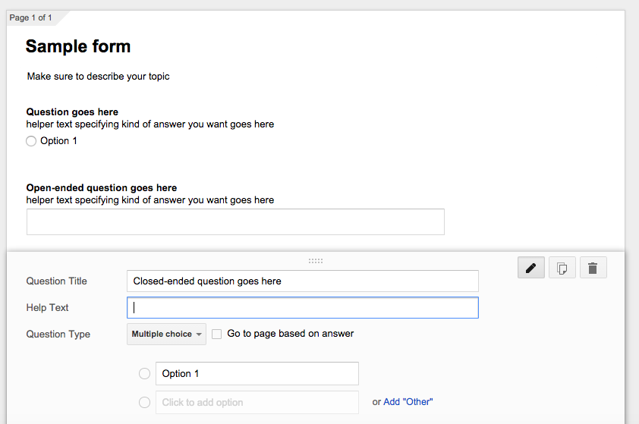
How to use Google Forms
Sample form
https://docs.google.com/forms/d/1vpqyiN6fte-3yG9uh672nux8L5cAz3s4TWiiwTnjgps/edit?usp=sharing

Slide 24
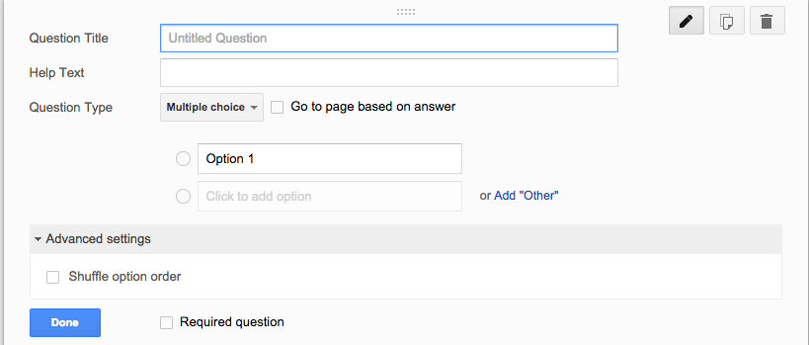
How to use Google Forms
yay!
Some of my favorite things: “Shuffle option order”
https://docs.google.com/forms/d/1vpqyiN6fte-3yG9uh672nux8L5cAz3s4TWiiwTnjgps/edit?usp=sharing

Slide 25
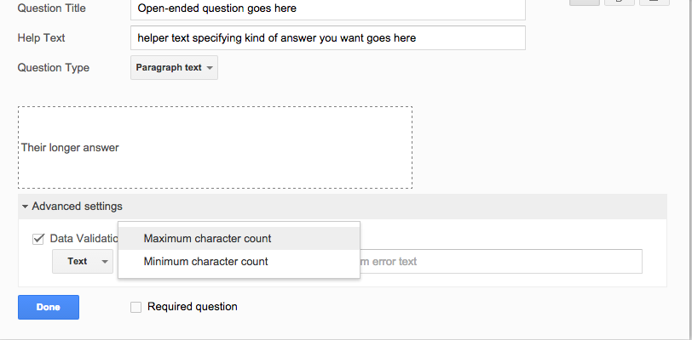
How to use Google Forms
muahahaha!
Some of my favorite things: “Maximum character count”
https://docs.google.com/forms/d/1vpqyiN6fte-3yG9uh672nux8L5cAz3s4TWiiwTnjgps/edit?usp=sharing

Slide 26
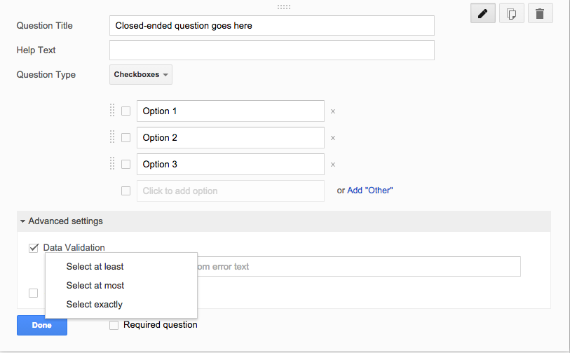
How to use Google Forms
Seriously, make your own life easier
Some of my favorite things: “Data validation”
https://docs.google.com/forms/d/1vpqyiN6fte-3yG9uh672nux8L5cAz3s4TWiiwTnjgps/edit?usp=sharing

